Slide 1
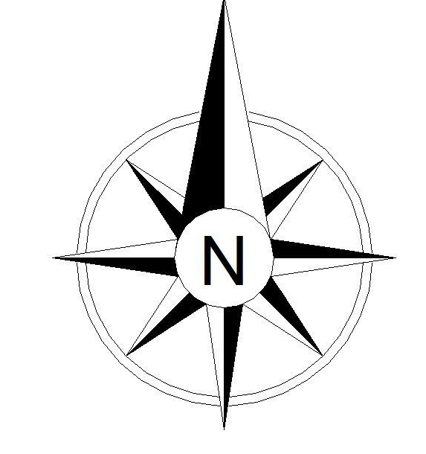
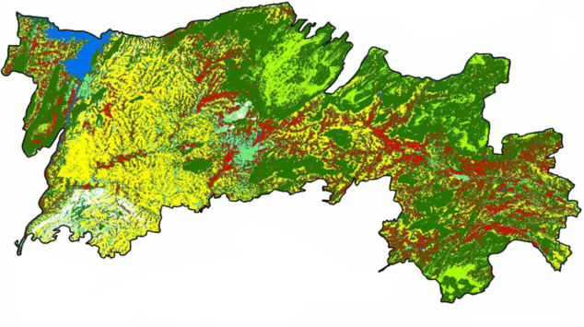
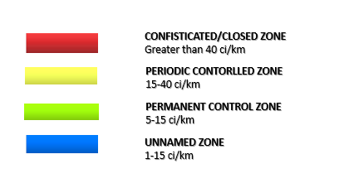
Title: Radiation Level inclusion in Salem
Map description and analysis
Salem district has 18 Taluks
Description on the radiation hazard scale
Confiscated Level:
It means that radiation doses are dangerously high and can make people seriously ill. Radiation doses are not high enough to cause death, but one or more symptoms of radiation sickness may appear.
Periodic Controlled zone:
It means that radiation doses are becoming high enough where we may expect increased risk of cancer in the years ahead for people who are exposed. Leukemia and thyroid cancers can appear in as few as 5 years after exposure.
Permanent control Zone :
It means that radiation levels in the environment are higher than the natural background radiation for that geographic area. However, these radiation levels are still too low to observe any health effects.
Unnamed Zone:
It means that radiation levels in the environment are within the range of natural background radiation for that geographic area. Low amounts of radioactive materials exist naturally in our environment, food, air, water, and consequently in our bodies.
Team Name: Sociatrons
Topic: Radiation level inclusion map
Mentor : Anand R
Team Members :
Rithvikailas G
Surya Narayanan CS
Team member/lead: Surya Narayanan CS
Organization: Sona College of Technology
Data courtesy: BHUVAN, Salem Region
Contact/email: cssuryanarayanan2k2@gmail.com

